Slide 1
Let’s start at the beginning - bits to character encoding in R
Alex Farach

Slide 2
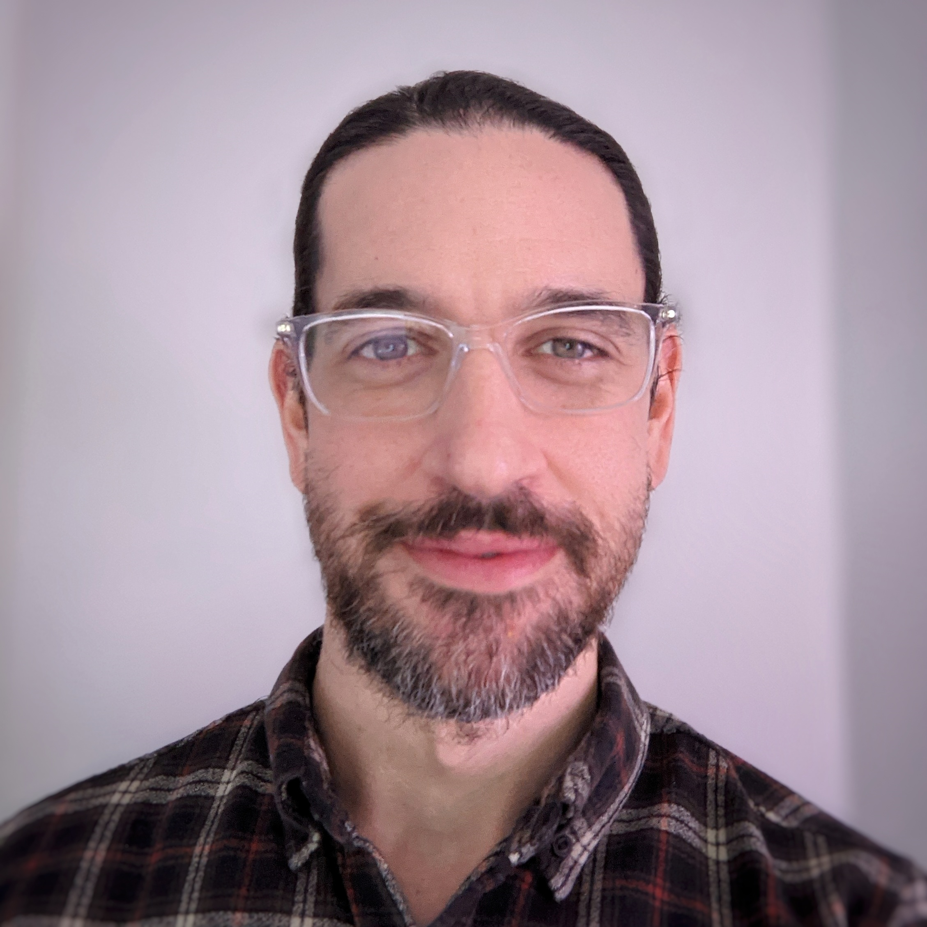
Hello! My name is Alex Farach and I’m a data scientist and analytics manager at Accenture Federal Services.
I think a lot about:
R & RStudio
Natural language processing (NLP)
Data visualization
Statistical learning
Currently working on:
github/farach/huggingfaceR

Slide 3
What is bits to character encoding?
Computer Human
Computer Human
Protocol

Slide 4
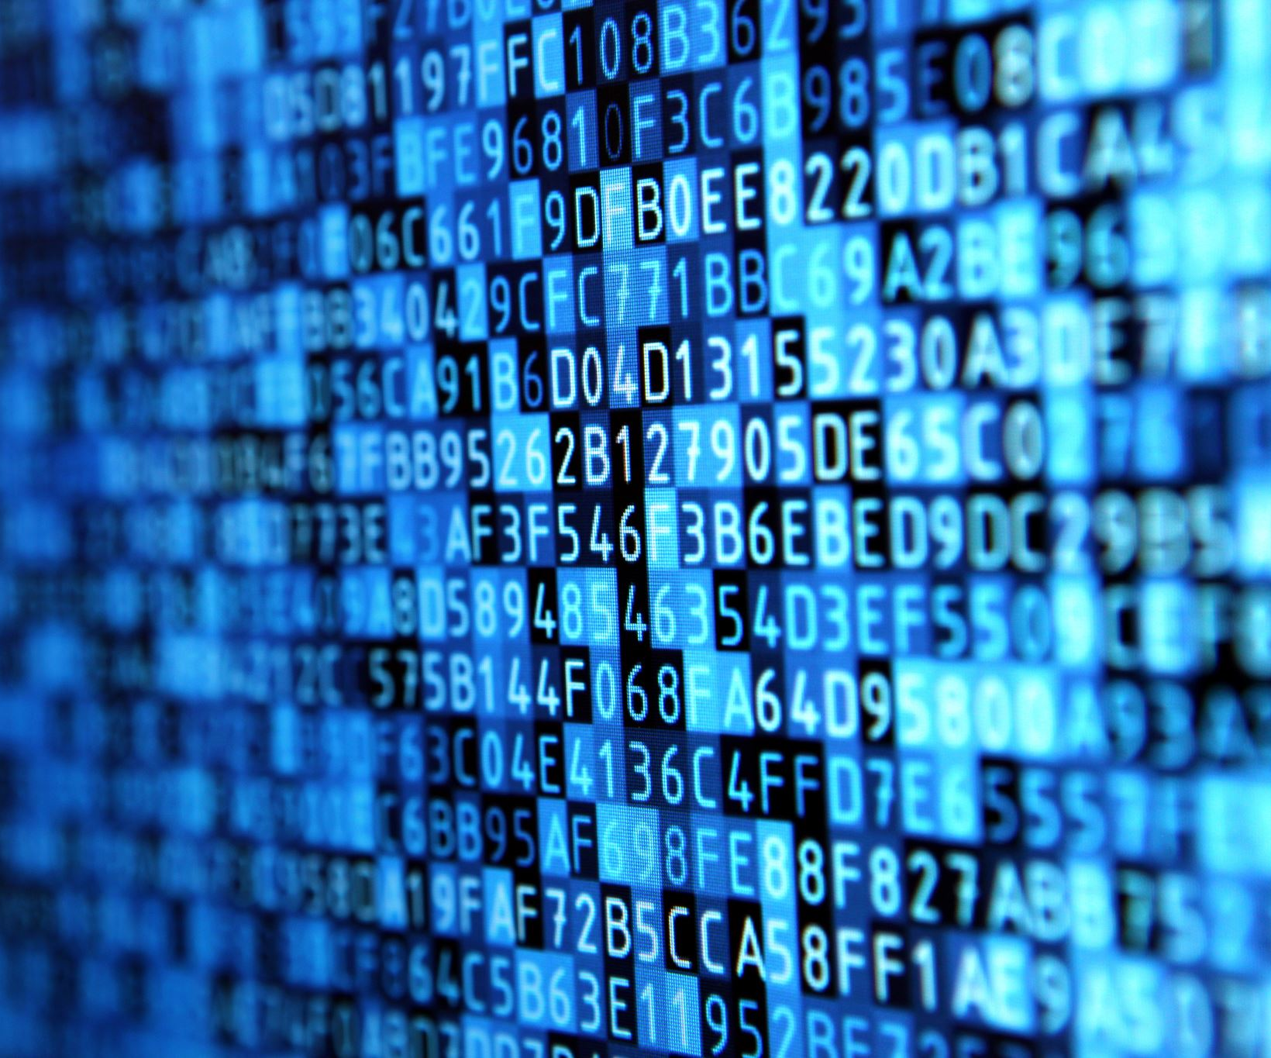
How would you describe the letter “A” to a computer?
A | 1 | 0
B | 2 | 1
C | 3 | 00
D | 4 | 01
E | 5 | 10
F | 6 | 11
… | … | …

Slide 5
How many bits are needed to represent 256 unique values?
2 values 1 bit
4 values 2 bits
8 … 3 …
16 … 4 …
32 … 5 …
64 … 6 …
128 … 7 …
256 values 8 bits = 1 byte

Slide 6
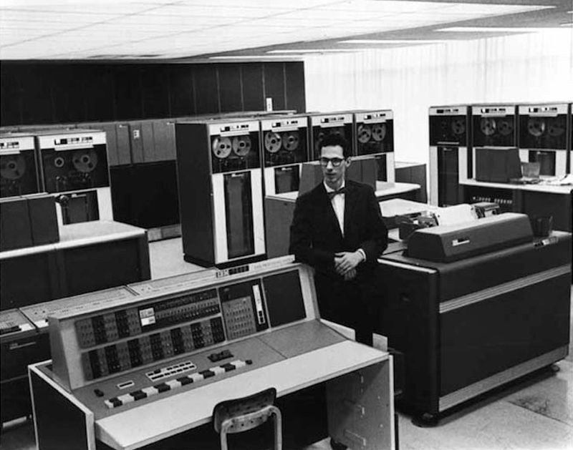
ASCII, Latin1, and Unicode
ASCII (American Standard Code for Information Interchange):
7 bits = 128 values

Slide 7
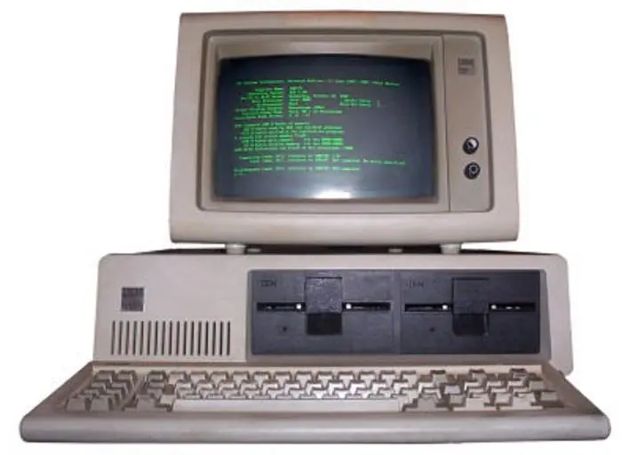
ASCII, Latin1, and Unicode
ASCII (American Standard Code for Information Interchange):
7 bits = 128 values
Latin-1 (ISO-8859-1):
8 bits = 256 values

Slide 8
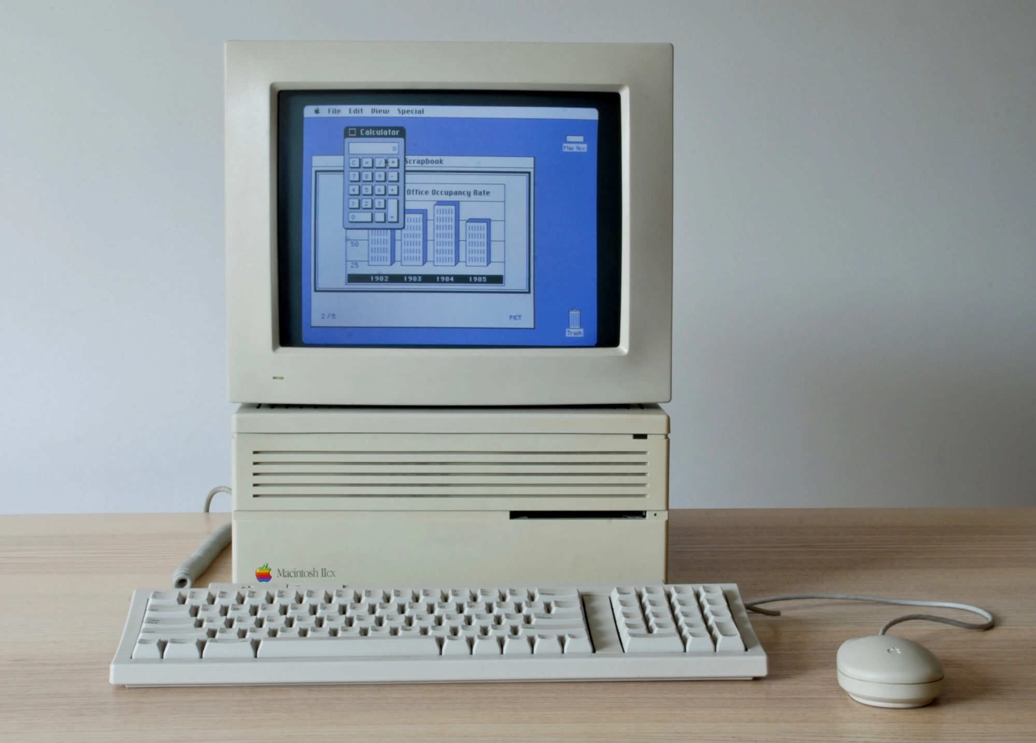
ASCII, Latin1, and UTF-8
ASCII (American Standard Code for Information Interchange):
7 bits = 128 values
Latin-1 (ISO-8859-1):
8 bits = 256 values
UTF-8 (Unicode Transformation 8-bit):
1:4 bytes = 1,112,064 values (or code points)!

Slide 9
Character String Encoding in R
R < 4.2.0
print(c("coffee", "café", "caf\u00E9", "caf\xe9")) Encoding(c("coffee", "café", "caf\u00E9", "caf\xe9"))
## [1] "coffee" "café" "caf<e9>" "caf<e9>" ## [1] "unknown" "latin1" "UTF-8" "latin1"
R >= 4.2.0
print(c("coffee", "café", "caf\u00E9", "caf\xe9")) Encoding(c("coffee", "café", "caf\u00E9", "caf\xe9"))
## [1] "coffee" "café" "café" "caf\xe9" ## [1] "unknown" "UTF-8" "UTF-8" "unknown"

Slide 10
R < 4.2.0
Sys.getlocale()
## [1] "LC_COLLATE=English_United States.1252;LC_CTYPE=English_United States.1252;LC_MONETARY=English_United States.1252;LC_NUMERIC=C;LC_TIME=English_United States.1252"
R >= 4.2.0
Sys.getlocale()
## [1] "LC_COLLATE=English_United States.utf8;LC_CTYPE=English_United States.utf8;LC_MONETARY=English_United States.utf8;LC_NUMERIC=C;LC_TIME=English_United States.utf8"

Slide 11
R < 4.2.0
l10n_info()
## $MBCS ## [1] FALSE ## ## $`UTF-8` ## [1] FALSE ## ## $`Latin-1` ## [1] TRUE ## ## $codepage ## [1] 1252 ## $system.codepage ## [1] 1252
R >= 4.2.0
l10n_info()
## $MBCS ## [1] TRUE ## ## $`UTF-8` ## [1] TRUE ## ## $`Latin-1` ## [1] FALSE ## ## $codepage ## [1] 65001 ## $system.codepage ## [1] 65001

Slide 12
R < 4.2.0
x <- "café" Encoding(x) x <- iconv(x, from = Encoding(x), to = "UTF-8") Encoding(x)
## [1] "latin1" ## [1] "UTF-8"
R >= 4.2.0
x <- "café" Encoding(x) x <- iconv(x, from = Encoding(x), to = "latin1") Encoding(x)
## [1] "UTF-8" ## [1] "latin1"

Slide 13
Character encoding, Tidyverse style
library(tidyverse) str_conv(string = "café", encoding = "latin1") str_conv(string = "café", encoding = "UTF-8") str_conv(string = "café", encoding = sample(stringi::stri_enc_list(), 1))
## [1] "cafÃ©" ## [1] "café" ## [1] "cafГ©"

Slide 14
Thank you!
Where to find me:
LinkedIn: https://www.linkedin.com/in/alex-farach/
GitHub: https://github.com/farach

